Slide 1
CPS 235 Object Oriented Programming Paradigm
Lecturer Aisha Khalid Khan
Pointers

Slide 2
Passing Arrays as Arguments using Pointers
void centimize(double*);
void main()
{
double array[4] = {10.0, 20.2, 40.4, 92.7};
centimize(array); //passing address of first element of array
for (int j = 0; j<4; j++)
cout<<array[j]<<" centimeters"<<endl;
getch();
}
void centimize(double* ptrd)
{
for (int j = 0; j<4; j++)
*(ptrd++) *= 2.54;
}
CPS235:Pointers

Slide 3
Pointers and the const modifier
Two places for const
int a;
const int* p =&a; //pointer to constant int
++p; //OK
++(*p); //ERROR: can’t modify const a
int* const q =&a; //constant pointer to int
++q; //ERROR: can’t modify const q
++(*q); //OK
const int* const r = &a; //constant pointer to constant int
++r; //ERROR: can’t modify const r
++(*r); //ERROR: can’t modify const a
CPS235:Pointers

Slide 4
Which statements are OK?
void MySub( const int * A )
{
*A = 50;
A++;
}
ERROR!
OK!
void MySub( int * const A )
{
*A = 50;
A++;
}
OK!
ERROR!
CPS235:Pointers

Slide 5
POINTERS AND DYNAMIC MEMORY
CPS235:Pointers

Slide 6
Dynamic Allocation
Use dynamic allocation to create an object at runtime
  C++ uses the new operator
The object is stored in a large free memory area named the heap (or free store)
The object remains on the heap either until you remove it or the program ends
The delete operator erases an object from the heap
CPS235:Pointers

Slide 7
Allocating memory on the heap
The heap is a large area of memory available for use by the program
The program can request areas, or "blocks", of memory for its use within the heap
In order to allocate a block of some size, the program makes an explicit request by calling the heap allocation function
The allocation function reserves a block of memory of the requested size in the heap and returns a pointer to it
CPS235:Pointers

Slide 8
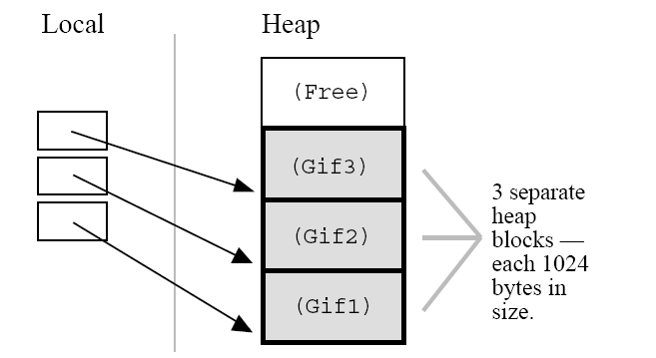
Allocating memory on the heap
Suppose a program makes three allocation requests to allocate memory to hold three separate GIF images in the heap each of which takes 1024 bytes of memory
CPS235:Pointers

Slide 9
De-allocating heap memory
When the program is finished using a block of memory, it makes an explicit deallocation request to indicate that the program is now finished with that block
The heap manager updates its private data structures to show that the area of memory occupied by the block is free again and so may be re-used to satisfy future allocation requests
CPS235:Pointers

Slide 10
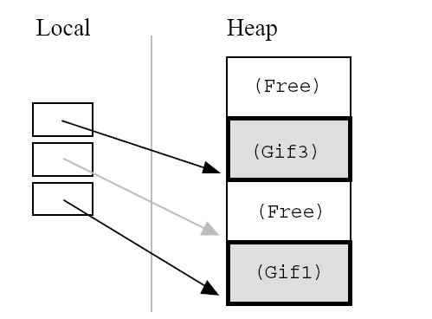
De-allocating heap memory
Here's what the heap would look like if the program de-allocates the second of the three blocks
After the de-allocation, the pointer continues to point to the now de-allocated block
The program must not access the deallocated block
This is why the pointer is drawn in gray — the pointer is there, but it must not be used
CPS235:Pointers

Slide 11
The new operator
Two forms:
  new datatype ;
  new datatype[IntExpression] ; //for arrays
int* intPtr = new int;
//creates a variable of type int on the heap and stores its address in intPtr
char* nameStr = new char[6];
//creates a six-element character array on the heap and stores the array’s base address in nameStr
CPS235:Pointers

Slide 12
Dynamic Variables
A dynamic variable is unnamed and cannot be directly addressed
  It must be indirectly accessed through the pointer returned by the new operator
  int* intPtr = new int;
  *intPtr = 37;
  cout<<*intPtr;
CPS235:Pointers

Slide 13
The delete operator
Two forms:
  delete datatype ;
  delete [] datatype; //for arrays
delete intPtr;
//gives back the variable pointed to by intPtr to the free store to make it reusable
delete [] nameStr;
//gives back the array pointed to by nameStr to the free store to be used again
CPS235:Pointers

Slide 14
The delete operator
Deleting the memory does not delete the pointer that points to it (intPtr in the previous example) and does not change the address value in the pointer
However, this address is no longer valid; the memory it points to may be changed into something entirely different
So, don’t use pointers to memory that has been deleted
CPS235:Pointers

Slide 15
Declaring array size at run-time
void main()
{
int* ptr_to_array;
int size;
cout<<"how many numbers do you want to enter?";
cin>>size;
ptr_to_array = new int[size]; //create an int array on the heap
for (int i=0; i<size; i++){
ptr_to_array[i] = 0;
cout<<ptr_to_array[i]<<'\t';
}
delete [] ptr_to_array; //free the heap memory
getch();
}
CPS235:Pointers

Slide 16
Use of new with strings
void main()
{
char* str = "Welcome to MCS !";
int len = strlen(str);
char* ptr = new char[len+1]; //+1 to make room for the null character to terminate the string
strcpy(ptr,str); //copy str to new memory area on the heap
cout<<"ptr = "<<ptr;
delete[] ptr; //release ptr's memory
getch();
}
CPS235:Pointers

Slide 17
new and delete with Objects
The new operator returns the address of a new object. The delete operator erases the object and makes it unavailable.
Student constructor called
Student * pS1 = new Student;
Student * pS2 = new Student(“John”,205);
.
.
// use the student for a while...
.
.
delete pS1; // memory gone!
delete pS2;
CPS235:Pointers

Slide 18
new and delete with Objects
class foo
{
public:
foo();
foo(int);
int func();
};
void main()
{
foo* fp1 = new foo;
foo* fp2 = new foo(100);
foo* fp3 = new foo[100];
delete fp1;
delete fp2;
delete [] fp3;
}
CPS235:Pointers

Slide 19

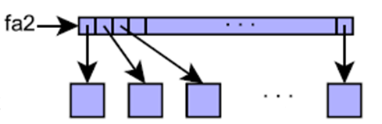
new and delete with Objects
foo f;
f.func();
foo* fptr = new foo;
fptr->func();
foo* fa1 = new foo[100];
fa1[50].func();
foo* fa2[100];
for(int i = 0; i<100; i++)
fa2[i] = new foo(i);
for(int i =0; i<100; i++)
cout<<fa2[i]->func()<<endl;
CPS235:Pointers

Slide 20
Using new in Functions
If you create an object inside a function, you may have to delete the object inside the same function. In this example, variable pS goes out of scope at the end of the function block
void MySub()
{
Student * pS = new Student;
// use the Student for a while...
delete pS; // delete the Student
} // pS disappears
CPS235:Pointers

Slide 21
Function Returning an Address
A function can return the address of an object that was created on the heap. In this example, the function's return type is pointer to Student.
Student * MakeStudent()
{
Student * pS = new Student;
return pS;
}
(more)
CPS235:Pointers

Slide 22
Receiving a Pointer
(continued)...
The caller of the function can receive the address and store it in a pointer variable. As long as the pointer remains active, the Student object is accessible.
Student * pS;
pS = MakeStudent();
// now pS points to a Student
CPS235:Pointers

Slide 23
Memory Leaks
A memory leak is an error condition that is created when an object is left on the heap with no pointer variable containing its address. This might happen if the object's pointer goes out of scope:
void MySub()
{
Student * pS = new Student;
// use the Student for a while...
} // pS goes out of scope
(the Student is still left on the heap)
CPS235:Pointers

Slide 24
Dangling Pointers
A dangling pointer is created when you delete its storage and then try to use the pointer. It no longer points to valid storage and may corrupt the program's data
double * pD = new double;
*pD = 3.523;
.
.
delete pD; // pD is dangling...
.
.
*pD = 4.2; // run-time error!
CPS235:Pointers

Slide 25
Avoid Dangling Pointers
To avoid using a dangling pointer, assign NULL to a pointer immediately after it is deleted.
And, of course, check for NULL before using the pointer.
delete pD;
pD = NULL;
.
.
if( pD != NULL ) // check it first...
*pD = 4.2;
CPS235:Pointers

Slide 26
Identify where you have a memory leak and a dangling pointer?
int* ptr1 = new int;
int* ptr2 = new int;
*ptr2 = 44;
*ptr1 = *ptr2;
ptr1 = ptr2;
delete ptr2;
CPS235:Pointers

Slide 27
Modified code
int* ptr1 = new int;
int* ptr2 = new int;
*ptr2 = 44;
*ptr1 = *ptr2;
delete ptr1; //to avoid memory leak
ptr1 = ptr2;
delete ptr2;
ptr1 = ptr2 = NULL;//to avoid dangling ptr
CPS235:Pointers

